Slide 2
OPEIU – ACTIVIST BRIEFING
Notes:
Welcome everyone to this OPEIU Activist Briefing for Labor 2016.

Slide 3
AGENDA
Target States – Labor’s work across the country.
Latest Polling – How’s it looking in our Tier 1 States?
Field Program - What it takes to WIN.
Latest Messaging – Tested messages to move our members.
Mobilizing our Members – Plugging in to Labor 2016
Notes:
I want to quickly review the goals of the webinar and what we’re going to cover today.
We will look at (review agenda).
In order to have a more interactive presentation, we will be conducting polls throughout the webinar to get your input.
The PPT and audio for this OPEIU briefing will be shared with you after the presentation.

Slide 4
TARGET STATES
Notes:
We want to start by providing an overview of our target states for the 2016 election cycle and take a quick look at polling in these battleground states.

Slide 5
2016 State campaign prioritization
TIER 1 STATE
TIER 2 STATE
Notes:
Review states and why we choose them – union density, multiple targets for labor, influential in the outcome.
Don’t have the resources to be in every state.
Can see here the light blue states are our tier 2 states, dark blue tier 1 states.

Slide 6
State | RTW* | Presidential | Governor | Legislature | US Senate
Florida |  | X |  | X | X
Missouri | X |  | X | X | X
Nevada |  | X |  | X | X
North Carolina |  | X | X |  | X
Ohio | X | X |  | X | X
Pennsylvania |  | X |  | X | X
Wisconsin |  | X |  | X | X
Colorado |  | X |  | X
Illinois |  |  |  |  | X
Indiana |  |  | X |  | X
Iowa |  | X |  | X | X
Kentucky | X |  |  | X
Michigan |  | X |  | X
Montana | X |  | X
New Hampshire | X | X | X | X | X
New Mexico | X | X |  | X
Virginia |  | X
West Virginia |  |  | X | X
*Potential threat of RTW on the ballot or in the legislature in the near future.
TIER 1
TIER 2
Notes:
A closer look at what’ at stake in each of these states – review.
The presidential race is key for a number of reasons… supreme court nominations and the potential outcome of several anti-union cases moving through the system to national right to work push.
Missouri – while not a presidential target state is key for the both the gubernatorial race and the state legislature in order to maintain a veto-proof majority to fight off right to work

Slide 7
Presidential Vote: General Public
3%
%
1%
4%
4%
5%
Source: Real Clear Politics Poll Average
Notes:
So let’s look at the current polling in the presidential race for our Tier 1 presidential states for the General Public.
These are averages of current polls…
The current margins are very slight….union contact, union turnout, union votes can swing these states.

Slide 8
MISSOURI
Senate Race
Gubernatorial Race
3%
11%
Source: Real Clear Politics poll average
Notes:
Review Missouri

Slide 9
NATIONAL BATTLEGROUND
UNION POLLING
Notes:
As we saw from the general public polling numbers, the races are tight. Let’s look more closely at polling numbers amongst union members and household members in the targeted states.

Slide 10
Member Type
17%
23%
9%
Margin Change:
+2%
-3%
-4%
Source: AFL-CIO Member Poll, September 2, 2016
Notes:
Review types

Slide 11
Geography
25%
18%
4%
Source: AFL-CIO Member Poll, September 2, 2016
Notes:
Review types

Slide 12
Age
9%
14%
21%
Margin Change:
+2%
-4%
-2%
Source: AFL-CIO Member Poll, September 2, 2016
Notes:
Review types

Slide 13
Income
23%
12%
Margin Change:
-1%
+1%
Source: AFL-CIO Member Poll, September 2, 2016
Notes:
Review types

Slide 14
Presidential Vote
15%
2%
5%
Source: Consortium National Survey, August 31, 2016
Notes:
Across the board we can see that union members are supporting Hillary Clinton and outperforming the general public.
Every conversation, every time we connect with our members and move them in the presidential election, we have an impact on the election. Let’s look at the impact of member to member conversations.

Slide 15
Reported Union Contact
Source: AFL-CIO Member Poll, September 2, 2016
Notes:
Progress in this election cycle…every percentage point makes a difference – the polls currently all of our battleground states with a 5 point margin or less.
This graph shows the percentage of union members that indicate they’re heard from their union. As you can see, we have a lot more work to do to reach out members, particularly for those on the door conversations. Door to door, like workplace conversations, can have a greater impact on who are members vote for and the likelihood they will turn out to vote.
AFL-CIO member surveys from the 2014 election showed an average 8 point increase of union voter turnout across targeted states with individual state impact ranging from a 3 point difference to as much as a 13 point difference. While the state increases varied, the constant was across states contacted union members increased their rate of voting.
The difference in contact rate turnout could be the winning numbers in this year’s election. The impact of our union member contact efforts this year can be the difference between a Clinton presidency and a Trump presidency.

Slide 16
FIELD PROGRAM
Notes:
We’ve looked at the current numbers for the general public and for our union members and households. We have our work cut out for us. Let’s take a look at what the field program looks like for labor 2016.

Slide 17
Quick poll – Your electoral experience
Press 1 – You have phone banked on a political campaign
Press 2 – You have canvassed on a political campaign
Press 3 – You have recruited volunteers for a political
campaign.
Press 4 – You haven’t done any of these yet but you’re
excited to be a part of it for this year’s election.
Notes:
But first, let’s get an idea of what kind of experience folks on the call have. We’re going to do a quick poll to get a sense of where folks are coming from with this kind of work. Remember, there is no right answer.
Whether you’ve been doing electoral work for your union for years or whether you’re new to electoral work and have never before participated in a political campaign – we’re all in this together.
Please press the number on your phone, not on your computer keyboard.
Review options.
Review poll results.

Slide 18
FOUR PILLARS OF THE FIELD PROGRAM
Worksite Conversations
Phone Banking
Local Union Mail
Door-to-Door Conversations
Notes:
There are four main components to the field program.
Review list.
Let’s go through each of these.

Slide 19
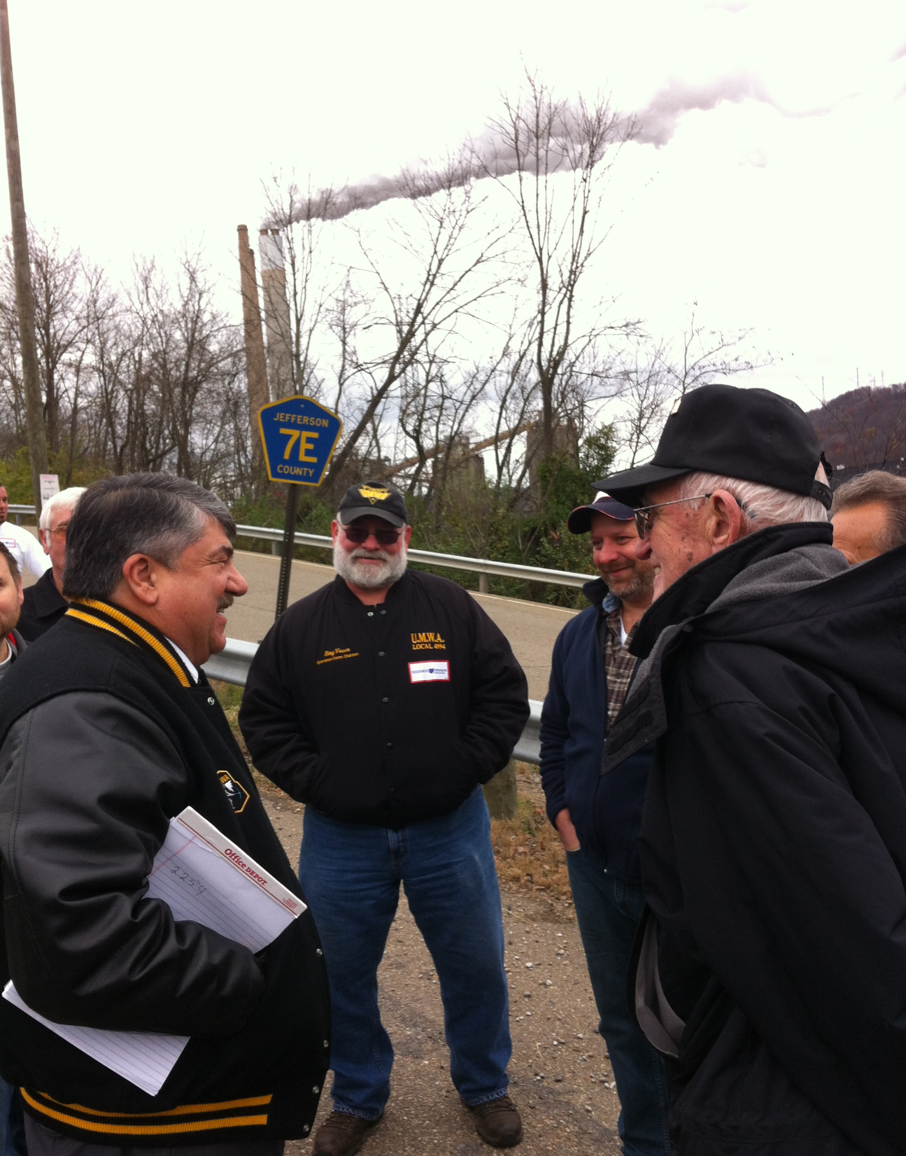


WORKSITE
CONVERSATIONS
Notes:
Worksite conversations offer us the best opportunity to engage our members in a thoughtful, targeted conversations. Recognizing there may be limitations for some worksites – like public sector locations – worksite conversations have a higher contact rate, there aren’t any “not homes” – we immediately have a personal connection through the work and the conversations can continue over time.
They also give us the opportunity to update contact information and use “pledge cards” to have members make a commitment to vote. We’ll look at the pledge cards later in this presentation.
Ideally, in the tier 1 and tier 2 states, we are working with local union coordinators to conduct 3 blitzes of their worksites during this election cycle to maximize worksite conversations.

Slide 20
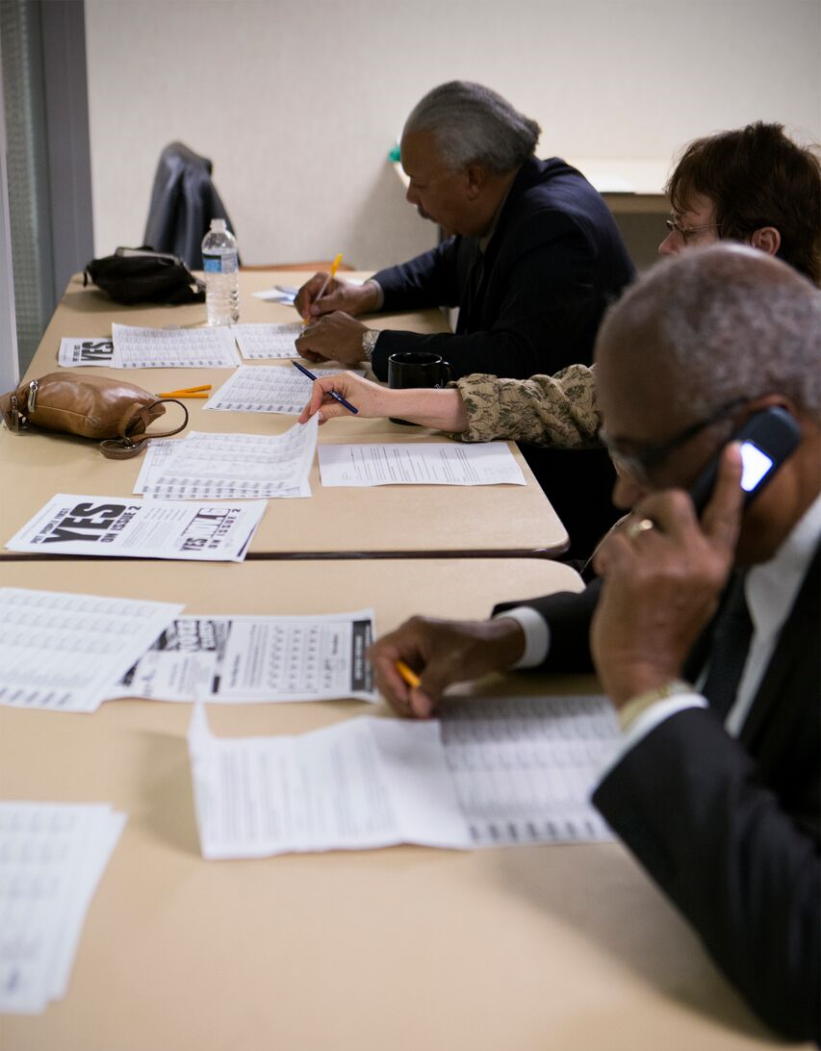
PHONE
BANKING
Notes:
The second element is member to member phone banks. Union members and activists are the most trusted messengers when talking to other union members. Phone banks are running around the country, including remote support in DC, California and other non-targeted states into this year’s target states.
There are many opportunities for activists to participate in phone bank conversations including through Virtual Phone Banks – a system where activists can make calls from their union hall or from their home using a virtual system.

Slide 21

Local Union Mail
Notes:
Just as union activists and members are the most trusted messenger when talking to other union members, mail from a member’s local union can have a greater impact than other campaign materials. Flyers and voter cards are very important, but a letter from the local union can have a much greater impact.
The goal for Labor 2016 is 3 pieces of local union mail to the membership during the election cycle. In Ohio, where I’m currently working, some local union’s did one mailing on voter registration and education on the candidates, a second mail piece on vote by mail and early voting with information on the candidates and will do a final piece closer to the election to turn out their members to vote.

Slide 22
DOOR - TO - DOOR
Notes:
Decades of research have consistently shown that face-to-face contact increases turnout in a variety of election types. Door-to-door canvassing has also proven to be an effective method for voter persuasion -- face to face contact can change voter’s minds on issues.
No one has the infrastructure to run an effective field program at the scale and speed that we can. And THAT’S why we’re doubling down on our ground game this year.
Member to member contact on the doors is key to our success. It gives us another opportunity to engage in conversation, move our members using issues they care about and ID them for our Get Out the Vote efforts.

Slide 23
messaging
Notes:
That’s an overview of the key components of the field program.
The most important element to most of these elements is (doors, phones, worksites) is having an effective 1-on-1 conversation. A conversation that includes tested messages, creates a personal connection and makes a clear ask. Let’s hear from all of you what concerns you’re hearing about from your members in the workplace.

Slide 24
Quick poll
In your workplace, what message or concerns are you hearing most?
Press 1 – Trade / Shipping Jobs Overseas
Press 2 – Women’s Rights / Equality in the Workplace
Press 3 – Jobs and the Economy
Press 4 – Guns / Second Amendment
Press 5 – National Security / Safety / Terrorism
Notes:
In your workplace, what message or concerns seem to come up most in conversations with members about the presidential candidates?
[CONDUCT POLL] Push the corresponding number on your phone if you’re hearing mostly comments about…
1: Trade or Shipping Jobs Overseas
2: Women’s rights and equality in the workplace
3: Jobs and the Economy
4: Guns and the Second Amendment
5: National Security, Safety and Terrorism
Review poll responses. We can see that…..

Slide 25
Tested MESSAGING
 | WORKERS’ RIGHTS | WOMEN | INFRASTRUCTURE
HILLARY CLINTON | Opposes “Right to Work.” Said she’s “sick of the union-busting in America.” Believes unions are critical to American middle class. Supports auto workers in Tennessee who want to join the UAW. Supports the fights that matter, like fair scheduling and paid time off. | Supports and understands what it means to be a woman in America. For instance, childcare is a heavy financial burden for young families and single moms. Hillary Clinton cares about that, and has a plan to address it. | Has pledged the biggest jobs program in America since World War II by funding an infrastructure bank as well as hundreds of billions in projects to fix roads, bridges, airports and water systems.
DONALD TRUMP | Is “100% in support” of Right to Work. Intimidated and threatened workers at his hotel in Las Vegas to try to kill a 2014 organizing drive. Has been sued thousands of times by contractors and workers for cheating them on pay. | Opposes equal pay for women. Claimed that women will make the same as men if they “do a good job.” Trump on the role of women: “I think putting a wife to work is a very dangerous thing” | Has no credible plan to fund infrastructure, and neither does the Republican Party.
Notes:
With the constant barrage of TV ads in this election, many of our members have negative views on Clinton that informed not by knowledge of her experience or positions on key issues, but rather by attack ads from the opposition.
It’s important to be prepared with tested messaging on issues our members care about, like trade or jobs, so that we can have effective conversations in the worksite.
Not all messaging is effective, even messaging we’ve used previously that moved people in the right direction may no longer work. The AFL-CIO continues to conduct polling with union members and households to test message frameworks and identify the most effective message frames for moving our members.
This grid highlights differences between the presidential candidates on three key issues – workers rights, women and infrastructure. Union members may not be clear on Trump’s position on Right to Work or that he opposes equal pay for women – key messages that can help us move our members to support Clinton for President.
Working in Ohio, I’ve had conversations with members who were leaning Trump but were unaware he is pro-right to work. By having the conversation and providing specifics on the candidates positions, we can move our members in the right direction.

Slide 26
Tested MESSAGING
 | TRADE | GUNS | NATIONAL SECURITY
HILLARY CLINTON | Against the TPP because it hurts workers’ rights and wages, and is bad for health and environmental rules. Promised to re-negotiate bad trade deals like NAFTA. Will crack down on currency manipulation and unfair trade practices. | Says someone on the FBI terrorist watch list shouldn’t be able to buy a gun with no questions asked. Favors keeping guns out of hands of terrorists, domestic abusers, violent criminals, and the severely mentally ill. | President Obama said, “There has never been a man or woman more qualified for this office than Hillary Clinton.”
DONALD TRUMP | Makes zero of his Trump branded products in America. His shirts, glasses, perfume, cuff links and suits are all made in Bangladesh, China, Honduras, and countries that make it easy for corporate interest to exploit workers. Says outsourcing creates jobs. Has been nominated by the party of outsourcing and corporate trade deals. | Has no plan to keep guns out of the hands of domestic terrorists or violent criminals | Trump is dangerous, divisive, and unfit to be president.
Notes:
Here are comparisons on three other key issues in this election – trade, guns and national security.
Some of you indicated ____ was concerns you are hearing from your members in the workplace. These message boxes are resources you can use to have effective conversations with your members on the issues they care most about.

Slide 27
TESTED MESSAGING
 | Paid Family Leave | Raising the Minimum Wage | Access to Higher Education
HILLARY CLINTON | For 30 years, Clinton has supported paid family leave, including paternity leave: “No one should have to choose between keeping their job and taking care of a sick family member, and no parent should have to go back to work right after they welcome a newborn baby.” | Clinton supports increasing the federal minimum wage to $12. She acknowledges that women are disproportionately represented in minimum-wage jobs, so that raising the minimum wage can help close the gender wage gap. | Clinton supports major new federal investments in higher education, grants, loans, and loan forgiveness programs.
DONALD TRUMP | “Trump’s plan is limited to new mothers who are married – so workers who are single women or fathers or adoptive parents or who need time off to deal with their own health or a family member’s illness would receive no help. Conservative economists are already on the record saying that maternity-only leave will result in employment discrimination and a larger gender wage gap.” | “Trump has changed his position on the minimum wage several times. He has said that he opposes raising the minimum wage, but now says he supports a $10 minimum wage “but states should decide,” which means he does not support a federally mandated minimum wage. | Trump says he believes Department of Education funding should be slashed and opposes student loan forgiveness, federal grants and loans.
Notes:
I know that we are preaching to the choir here, but let’s pause for a moment to compare Hillary and Trump on a couple of other issues.
Looking at where Clinton and Trump stand on these issues, it’s no contest who is the right candidate for working families:
For example, Hillary Clinton has a long record of supporting paid family medical leave.
She proposes up to 12 weeks of paid family and medical leave to care for a new child or a seriously ill family member, and up to 12 weeks of medical leave to recover from a serious illness or injury of their own. And she will ensure working people to earn at least two-thirds of their current wages, up to a ceiling, while on leave.
She supports raising the minimum wage – something that would have a tremendous impact on working families.
While we may think the choice is obvious as to which candidate is better for working people, it can sometimes be challenging to engage our members in a political conversation and pivot to the economic issues at stake in this election. Even for the most experienced organizers and activists, it can be difficult to pivot.
As part of the messaging resource materials, we have also developed pivot messages to help move our members.
Let’s look at a pivot for a challenging response.

Slide 28
Pivot Points – neither candidate
Politics is a team sport. It’s no question which candidate is the team player. When Hillary was in the Senate, she won respect from Republicans for working across the aisle: Two-thirds of her bills had GOP co-sponsors and included common ground with both liberals—she voted with Bernie Sanders 93% of the time—and with some of Congress' most conservative lawmakers.
Hillary has a powerful plan to invest in America to create jobs and boost manufacturing. A business group studied Trump’s ideas, and found he’ll cost America 3.4 millions. Not Hillary. The same business group that gave trump an F-minus gave Hillary an A-plus, because her plan will create more than 10 million jobs, and her website has TONS of details about how she’ll get it done. It’ll be the biggest federal jobs plan since President Eisenhower built the Interstate highway system. That’s something to vote for.
Your vote matters.
  Florida: In 2000, George W. Bush won the presidency by winning Florida, and he won there by only 537 votes. Think of how different things might be if Bush was never president.
  Nevada: In 1998, Harry Reid won re-election by only 428 votes – out of more than 430,000 votes cast.
  Ohio: In 2004, George W. Bush won re-election by winning Ohio, and he won there by fewer than 14 votes per precinct.
Notes:
Show of hands – press 1 on your phone if you’ve heard something along the lines of, “Honestly, I can’t stand either Hillary Clinton or Donald Trump - I’m not voting for either.”
[CONDUCT POLL – HAVE PARTICIPANTS PRESS 1 ON THEIR PHONE IF THEY’VE HEARD THIS COMMENT]
Reinforcing the notion that “politics is a team sport” and providing an example of the impact of a small margin of votes on the outcome of an election before pivoting can be a powerful message to move our members. Incorporating examples that resonate with your members is even more effective – here are a few examples of elections won by narrow margins.
[REVIEW EXAMPLES ON SLIDE]
All of these message materials will be provided in the resource materials for this briefing. Depending on your worksite or your membership, you may need to adapt these materials to fit the unique situation of your worksite and your members.
These messaging materials are designed to help union activists have effective one on one conversations. Let’s look more closely at the mechanics of an effective one on one.

Slide 29
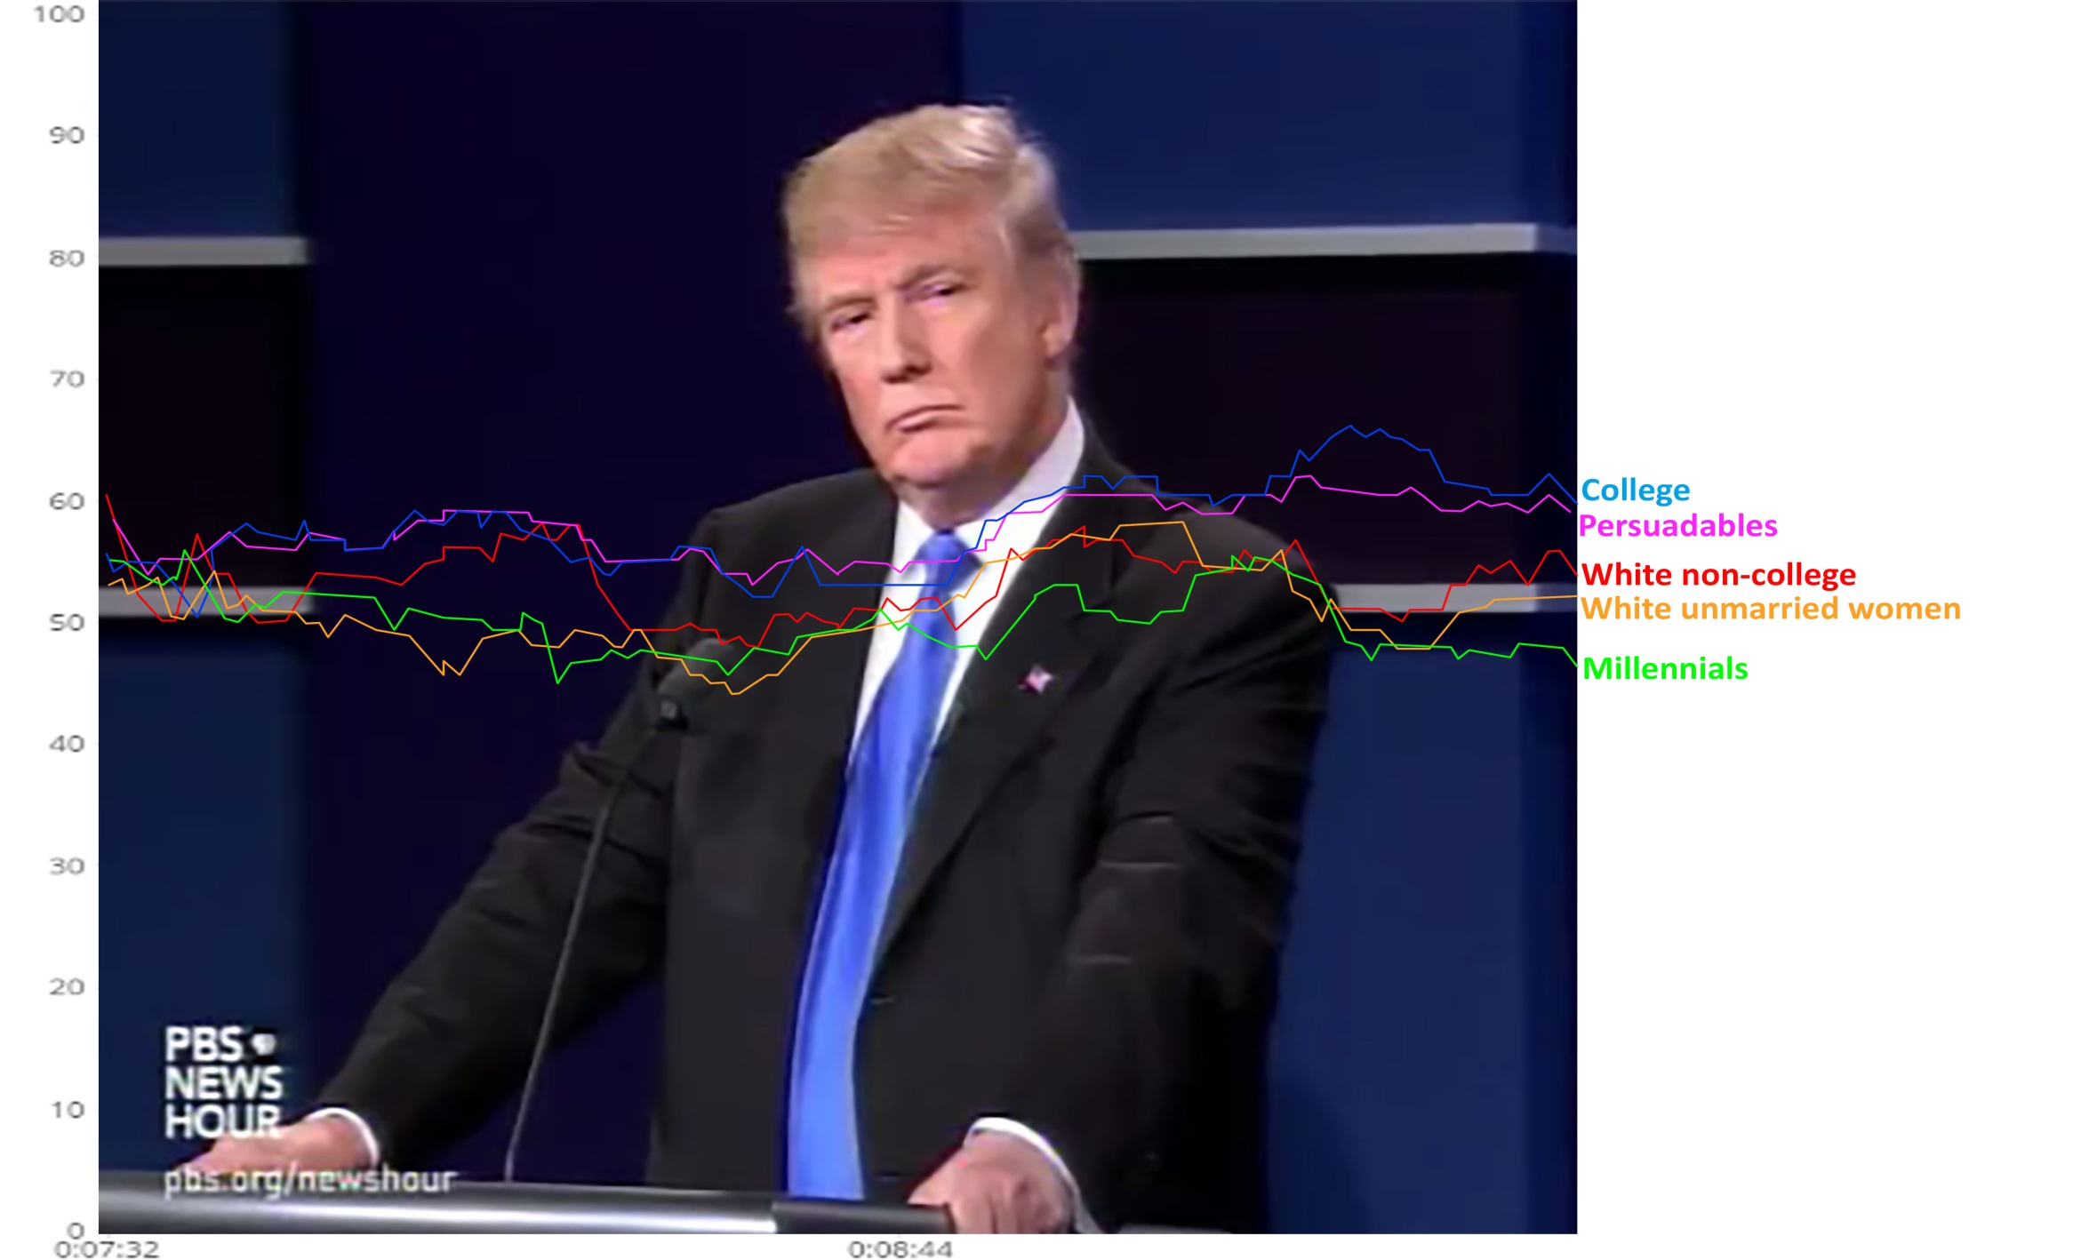
Lines rise at ending offshoring of jobs, diverge at tax plan
I'll be reducing taxes tremendously
You look at what China is doing to our country ..
But we have to stop our jobs from being stolen from us. We have to stop our companies from leaving the United States
You look at what China is doing to our country in terms of making our product. They're devaluing their currency, and there's nobody in our government to fight them. [..] But we have to stop our jobs from being stolen from us. We have to stop our companies from leaving the United States and, with it, firing all of their people. [..] Under my plan, I'll be reducing taxes tremendously, from 35 percent to 15 percent for companies, small and big businesses. That's going to be a job creator like we haven't seen since Ronald Reagan. [..]. We have to renegotiate our trade deals, and we have to stop these countries from stealing our companies and our jobs.
Source: Greenberg Quinlan Rosner Research, Oct. 2016

Slide 30
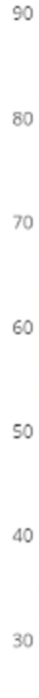
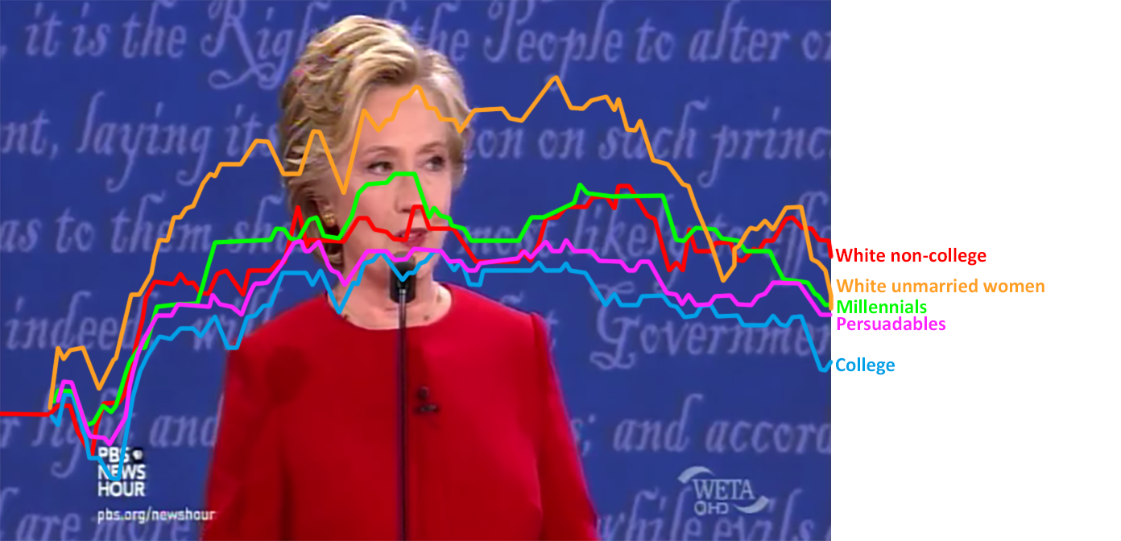
Progressive economic agenda gets rave response
Paid family leave, earned sick days. Let's be sure we have affordable child care and debt-free college.
An economy that works for everyone, not just those at the top
Do it by having the wealthy pay their fair share
First, we have to build an economy that works for everyone, not just those at the top. [..] That starts with raising the national minimum wage and also guarantee, finally, equal pay for women's work. [..] If you help create the profits, you should be able to share in them, not just the executives at the top. And I want us to do more to support people who are struggling to balance family and work. [..]So let's have paid family leave, earned sick days. Let's be sure we have affordable child care and debt-free college. [..]We're going to do it by having the wealthy pay their fair share and close the corporate loopholes.
Source: Greenberg Quinlan Rosner Research, Oct. 2016

Slide 31
FIVE STEPS TO EFFECTIVE 1-ON-1 CONVERSATIONS
INTRODUCE: Start with a conversational and comfortable approach. “Hi, how are you?”
SHARE: Tell them you’ve been talking to other members in the workplace about how they’re fairing in the current economy. Share how you or someone close to you has been impacted by the economy. Say that everyone at the workshop had a similar story.
INQUIRE: Ask the person what their experience have been.
INFORM: Explain that our out-of-balance economy is the result of deliberate policy choices and we need people like Hillary Clinton in office who will actively work to create an economy that works for everyone..
ASK: Invite the member to be part of the local’s efforts to change the rules by volunteering for canvassing or phone banking in this election.
Notes:
What makes for an effective 1-on-1 conversation is a structured conversation that engages others.
Effective 1-on-1 conversations are as much about listening as they are about speaking – listening to the member, hearing their concerns and tying their interests into voting for Clinton using tested messaging. Tested messaging provides us the language framework for one on one conversations.
We encourage folks to structure the conversation like this. Introduce, Share, Inquire, Inform, Ask. Let’s walk through each of these steps.
First—introduce. The reason that you are the best messenger for these conversations is that you’re a coworker, you’re a person these folks know, and you have credibility that a tv ad or a piece of mail doesn’t. You have the ability to have a conversation in a non-controversial, non-awkward way. So that’s all you need to do – introduce yourself and connect as a union member.
Second – share. Share that you’re volunteering for the union and why. There’s no perfect script to this – all of us get involved for different reasons, and that’s okay. And share your connection with the economy – what’s your personal story for you and your family?
Third – Inquire. After you share, ask them what they’re thinking about the election, how it will impact their family or how they think it will impact your shared work. Listen to their concerns – this will provide you the connection to the messaging and the best way to pivot.
Fourth – Inform. Where it makes sense, share the contrasts between Hillary and Trump. As we saw when looking at the message boxes, there are plenty of ways to draw contrasts between the two candidates – tie the contrast to the member’s concern.
It’s pretty easy. Donald Trump supports right-to-work, Hillary Clinton doesn’t—in fact, while she has stood with workers on picket lines, he’s crossed picket lines. She supports raising the minimum wage, he doesn’t. She supports equal pay, he doesn’t. The stakes in this election couldn’t be clearer.
Finally – ASK. Get a commitment—as the conversation progresses, make a hard ask, “So you’ll commit to voting this November? Can you fill out this pledge card?”
That’s the framework for an effective one on one conversation – a structured approach using tested messaging. There’s one last step to consider for effective one on ones.

Slide 32
PERSONALIZING THE RAP
Script Review (tested messaging, clear ask)
Making a Personal Connection
Practice
Notes:
Personalizing your rap.
Being an effective messenger is making the personal link to the big picture. How can you help our members connect their personal experiences to the presidential race and voting?
Beyond the conversation guide itself, let’s walk through some best practices.
For each type of conversation – worksite / phone / canvass – we have scripts that outline a structured conversation using tested messaging with a clear ask. Language matters and the scripts are built on our experience and our data. You should absolutely personalize these things, know that the scripts are designed to help make these conversations successful. Personalize the script – make that connection.
Next, and we’ve said this already, the reason we do this is that a conversation between two people will always be more effective than a piece of mail or a tv ad. Beyond that, a conversation between coworkers has inherent benefits – you know each other, you know each others work, and lives, etc.
Also practice makes perfect. One thing to be confident in is that you are a real person – your coworkers don’t expect you to be policy experts to know the answer to every question about every candidate. So don’t feel like you need to memorize talking points or policy positions. You’re a real person talking to real people.
That said, practice the rap, make sure you’re comfortable with it.

Slide 33
MOBILIZING OUR MEMBERS
Notes:
We’ve looked at recent polling, reviewed some tested messaging and gone through the elements for an effective one on one conversation.
Let’s talk about How We Mobilize Our Members.

Slide 34


From Flyers to Conversations
Notes:
The key to mobilizing our members in the most powerful way we can – is to move beyond handing out flyers to engaging our members in real conversations about what’s important to them and how they can be part of creating change by voting, volunteering and talking to others.
Whether on the phone, on the door, or in the worksite – it’s all about the conversation.

Slide 35
PLUGGING IN
Local Union Mail
  2 Pieces to Local Members on targeted issues
Member to Member Phone Banks (Virtual Phone Banks)
  Every day
  Contact: Michelle Penson at (202) 637-5189 or mpenson@aflcio.org
Member to Member Canvassing
  Every weekend and most weeknights
  Every day starting with “GOTV”
Recruiting Volunteers
  Union meetings
  Steward meetings
  Wherever union members gather
Notes:
Where can we engage our members?
Review the four pieces

Slide 36
RESOURCES
Notes:
We’ve gone through a lot of information in a short period of time and there’s much more we could cover but you all have busy lives and other work to get back to.
I want to review some key resources available to all of you to assist you in your member to member outreach.

Slide 37
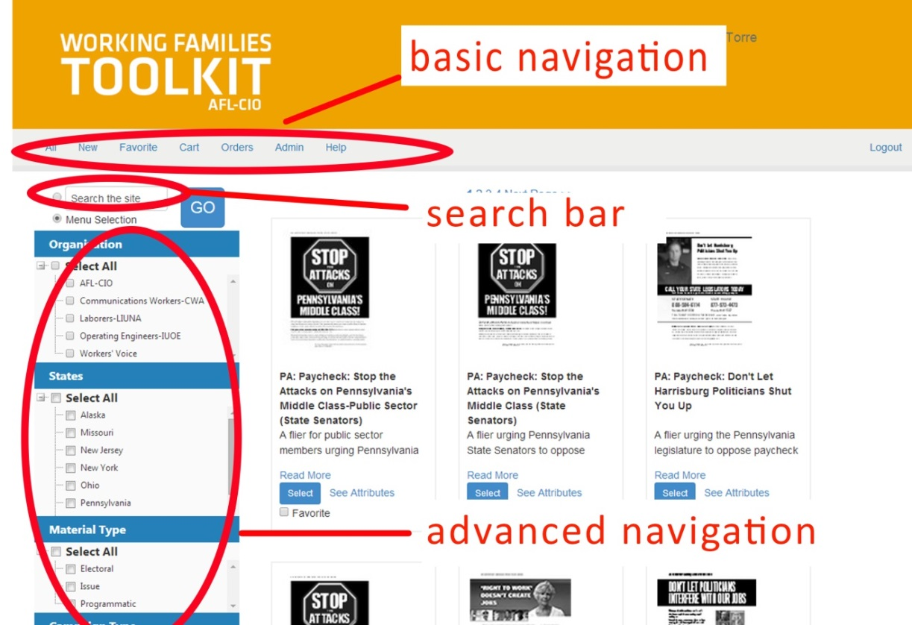
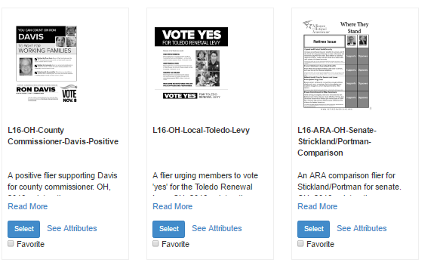
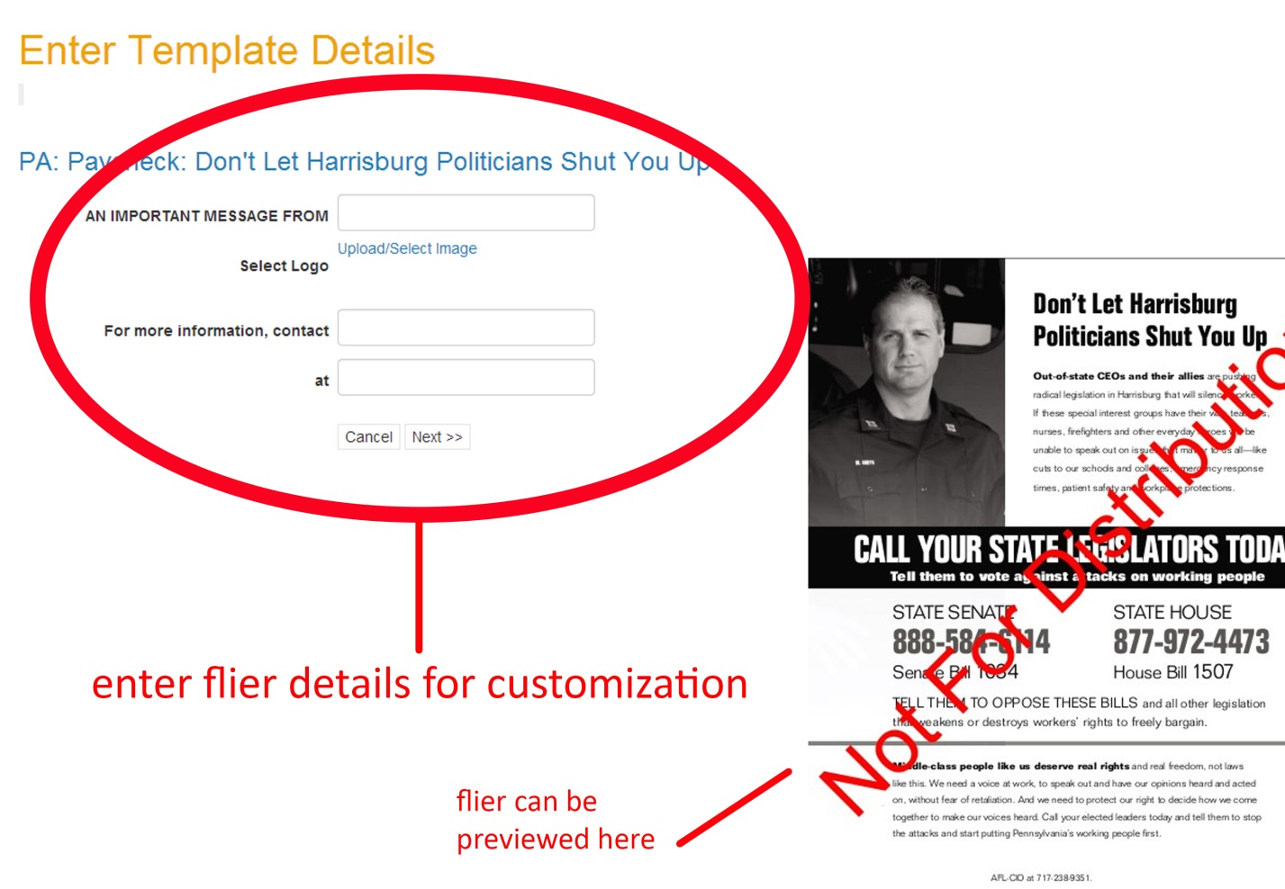
WORKING FAMILIES TOOLKIT
Notes:
First is the working families toolkit. I’d like to get a sense of how many folks on the call have used the toolkit.
If you’ve used the working families toolkit or have heard of the toolkit please press 1 on your phone.
Review responses.
The working families toolkit is a valuable online resource where you can access campaign flyers for electoral and legislative issues, training materials and other information materials.
I’m going to briefly walk through a few screen shots but we will provide you an electronic guide that provides a detailed overview of how to access and use the working families toolkit to personalize flyers for your local.
1 Overview of first page
2 Customization
3 Sample materials – flyers can be ordered or downloaded in PDF format. The toolkit is a year round resource.

Slide 38
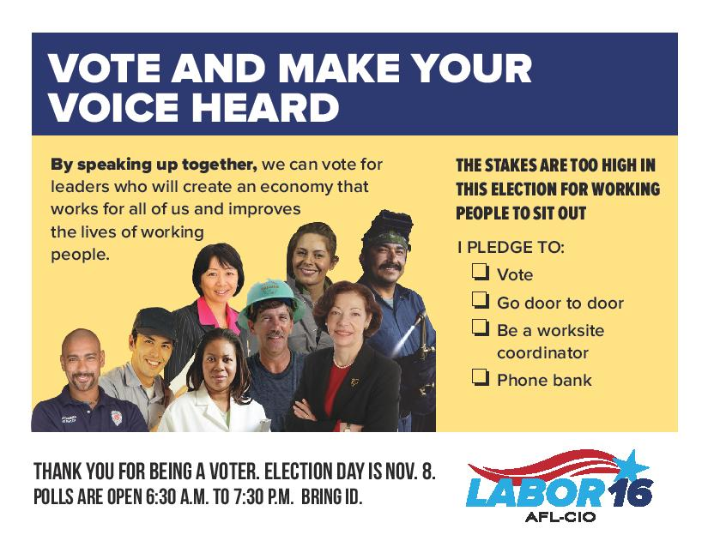
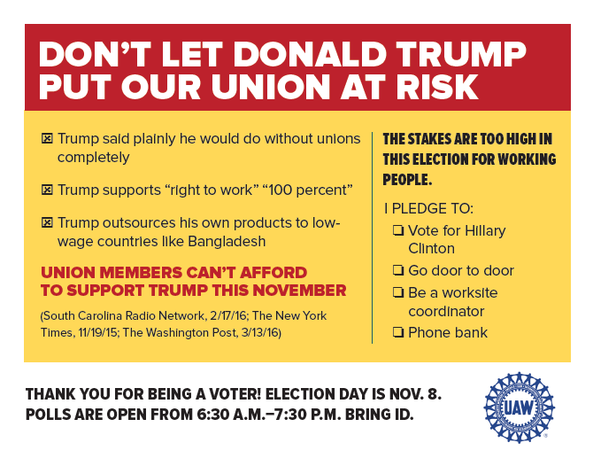
Pledge cards
Notes:
I mentioned pledge cards earlier in the briefing. Pledge cards are an effective tool for updating member information and getting members to commit to voting.
They can also help us track worksite conversations in order to assess our progress towards our goals.
On the left is a pledge card from Ohio used to engage members and to track progress with 1-on-1 conversations in the worksite. As you can see on the right hand slide it asks members to pledge to take action 1 (vote, phone bank, etc.) and provides a 2 reminder about election day and polling hours.
The cards are completed by members during a 1-on-1 conversation, collected, data entered, and mailed back to members to remind them of their commitment to vote. Cards like this one, that captures members contact information, in addition to being good literature – helps us confirm that worksite conversations are happening.
The pledge cards are an essential component of our worksite program – they reinforce members’ plan to vote and increase voter participation. Cards are available now in AFL-CIO field offices in Tier 1 states and can be ordered on the working families toolkit. They can also be personalized for an individual union as seen here on the right with a 3 UAW example.

Slide 39
WORKING FAMILIES TOOLKIT
www.wftoolkit.org
Questions about the Working Families Toolkit and the flier ordering process:
      Emmy Torre
      etorre@aflcio.org
      202-637-3962
Notes:
That was a very brief overview, and again, we will send you all the guide for how to access and use the toolkit.
Here’s the web address and the AFL-CIO contact person if you have questions about accessing or ordering from the toolkit.

Slide 40
Labor 2016 – resource index
Bit.ly/Labor2016Index (case sensitive)
  Training Modules
  State Leads Contact Information
  Staging Locations
  Release Staff Welcome Packets
  Release Staff Resources
  Hotel Recommendations
  Zone Maps
Notes:
We have created an online resource index to make it easier for union activists to access Labor 2016 resources.
The link is here at the top – please note it IS case sensitive.
Some of the materials you can find on the index are listed here
Review a few of the examples
The materials are frequently updated.

Slide 41
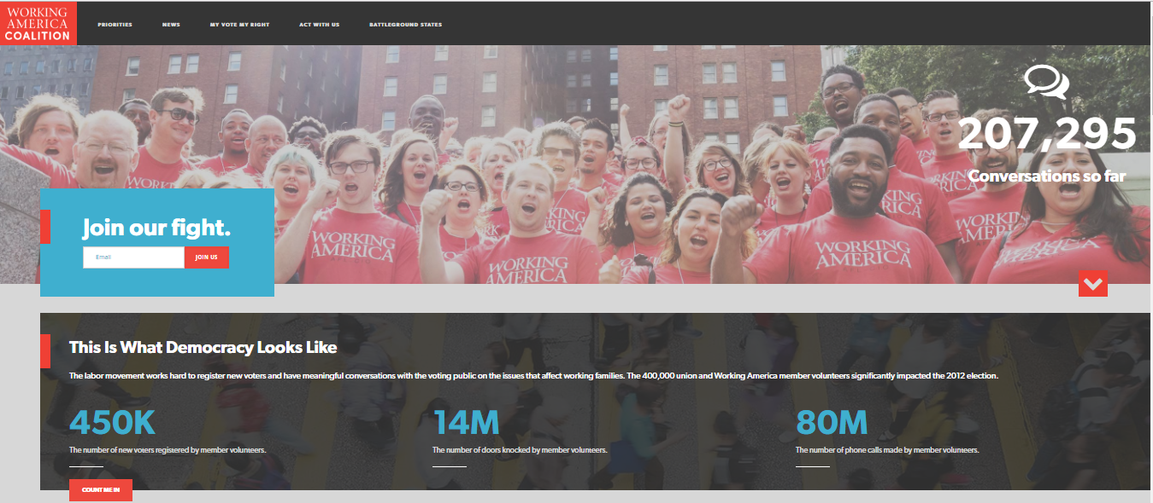
Working America coalition – RESOURCE PAGE
www.workingamericavotes.org
Notes:
The working American coalition resource page is a great tool for information on voter registration, voter rights and how to get active in a state.
1 Here’s the link

Slide 42
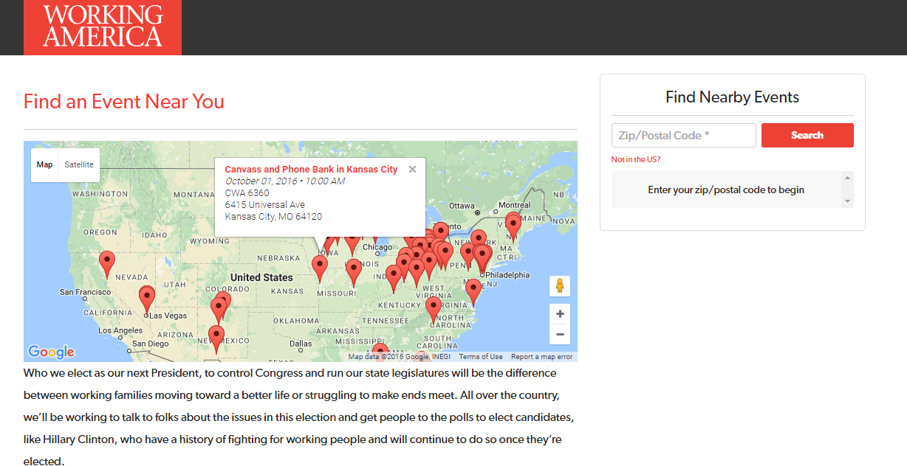
Working America coalition – events page
http://bit.ly/WAC2016Events
Notes:
In addition, members can find phone banks, walks or other events close to them by using the event locator tool shown here. By putting in their zip code they can find a list of nearby events.
2 Here’s the link.

Slide 43
OTHER RESOURCE LINKS
Labor 2016 Training Materials: http://bit.ly/Labor16TrainingMaterials
Women’s Toolkit Labor 2016:
go.aflcio.org/womenstoolkit2016
Notes:
Two other helpful links –
The training materials link has a variety of resource materials available for your to use and adapt to fit your local and your worksites – from how to have effective one on one conversations, setting up phone banks to worksite organizing campaigns.
The other link is for the women’s toolkit for labor 2016 that has resources for running worksite organizing campaigns for women members using targeted messaging and pledge cards.
Both links have a wealth of resources that you may find helpful for your member to member work.

Slide 44
STATE LEADS
Florida: David Driscoll Knight - 954.651.0145
Missouri: Ryan Burke - 314.258.6466
Nevada: Gariety Pruitt - 702.290.2847
North Carolina: Aiden Graham - 919.597.8199
Ohio: Kate Jacob - 419.705.1538
Pennsylvania: Ramon Becerra - 312.330.2040
Wisconsin: Steve Kwaterski - 414.975.8650
Notes:
Lastly, there are the folks on the ground in the Tier 1 states that can provide support for engaging your members in the campaign and answering questions specific to a state.
Here are the state leads for the Tier 1 states.

Slide 45
QUESTIONS?
Notes:
I know we’ve covered a lot of information in a short period of time and we have a few minutes left for questions so I’d like to open up for questions.
If you have a question please press 1 on your phone.
Finally, to wrap up, we’d like to get feedback from all of you on the information in this briefing. IF TIME PERMITS GO TO NEXT SLIDE – OTHERWISE
Thank you all for your participation in today’s OPEIU activist briefing. We hope this information is helpful to you in your member to member engagement work for Labor 2016. The conversations you have with your members can be the deciding factor in this election!

Slide 46
Quick poll – feedback on the briefing
Press 1 – The information was great and I have a ton of new tools to use in engaging my members. I’m ready to go!
Press 2 – There’s a lot of good information now I just need time to review all the resources and get started. Count me in!
Press 3 – I’m fired up and there is good information but I have a few questions before I get started.

