Slide 1
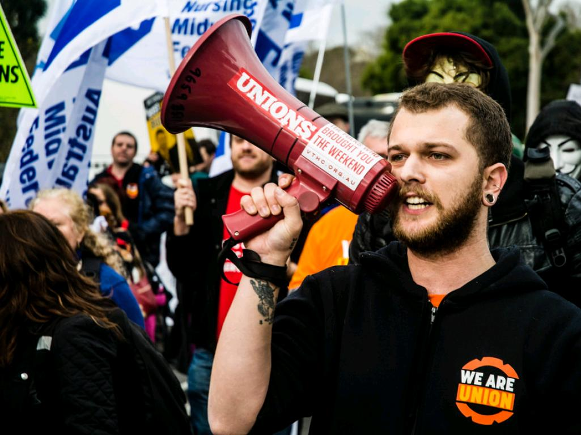
OPEIU Public Employee Sector Webinar:
Open Shop is Coming
March 7, 2017
cc: Corey Oakley - https://www.flickr.com/photos/57496734@N07

Slide 2
OPEIU Public Employee Members

Slide 3
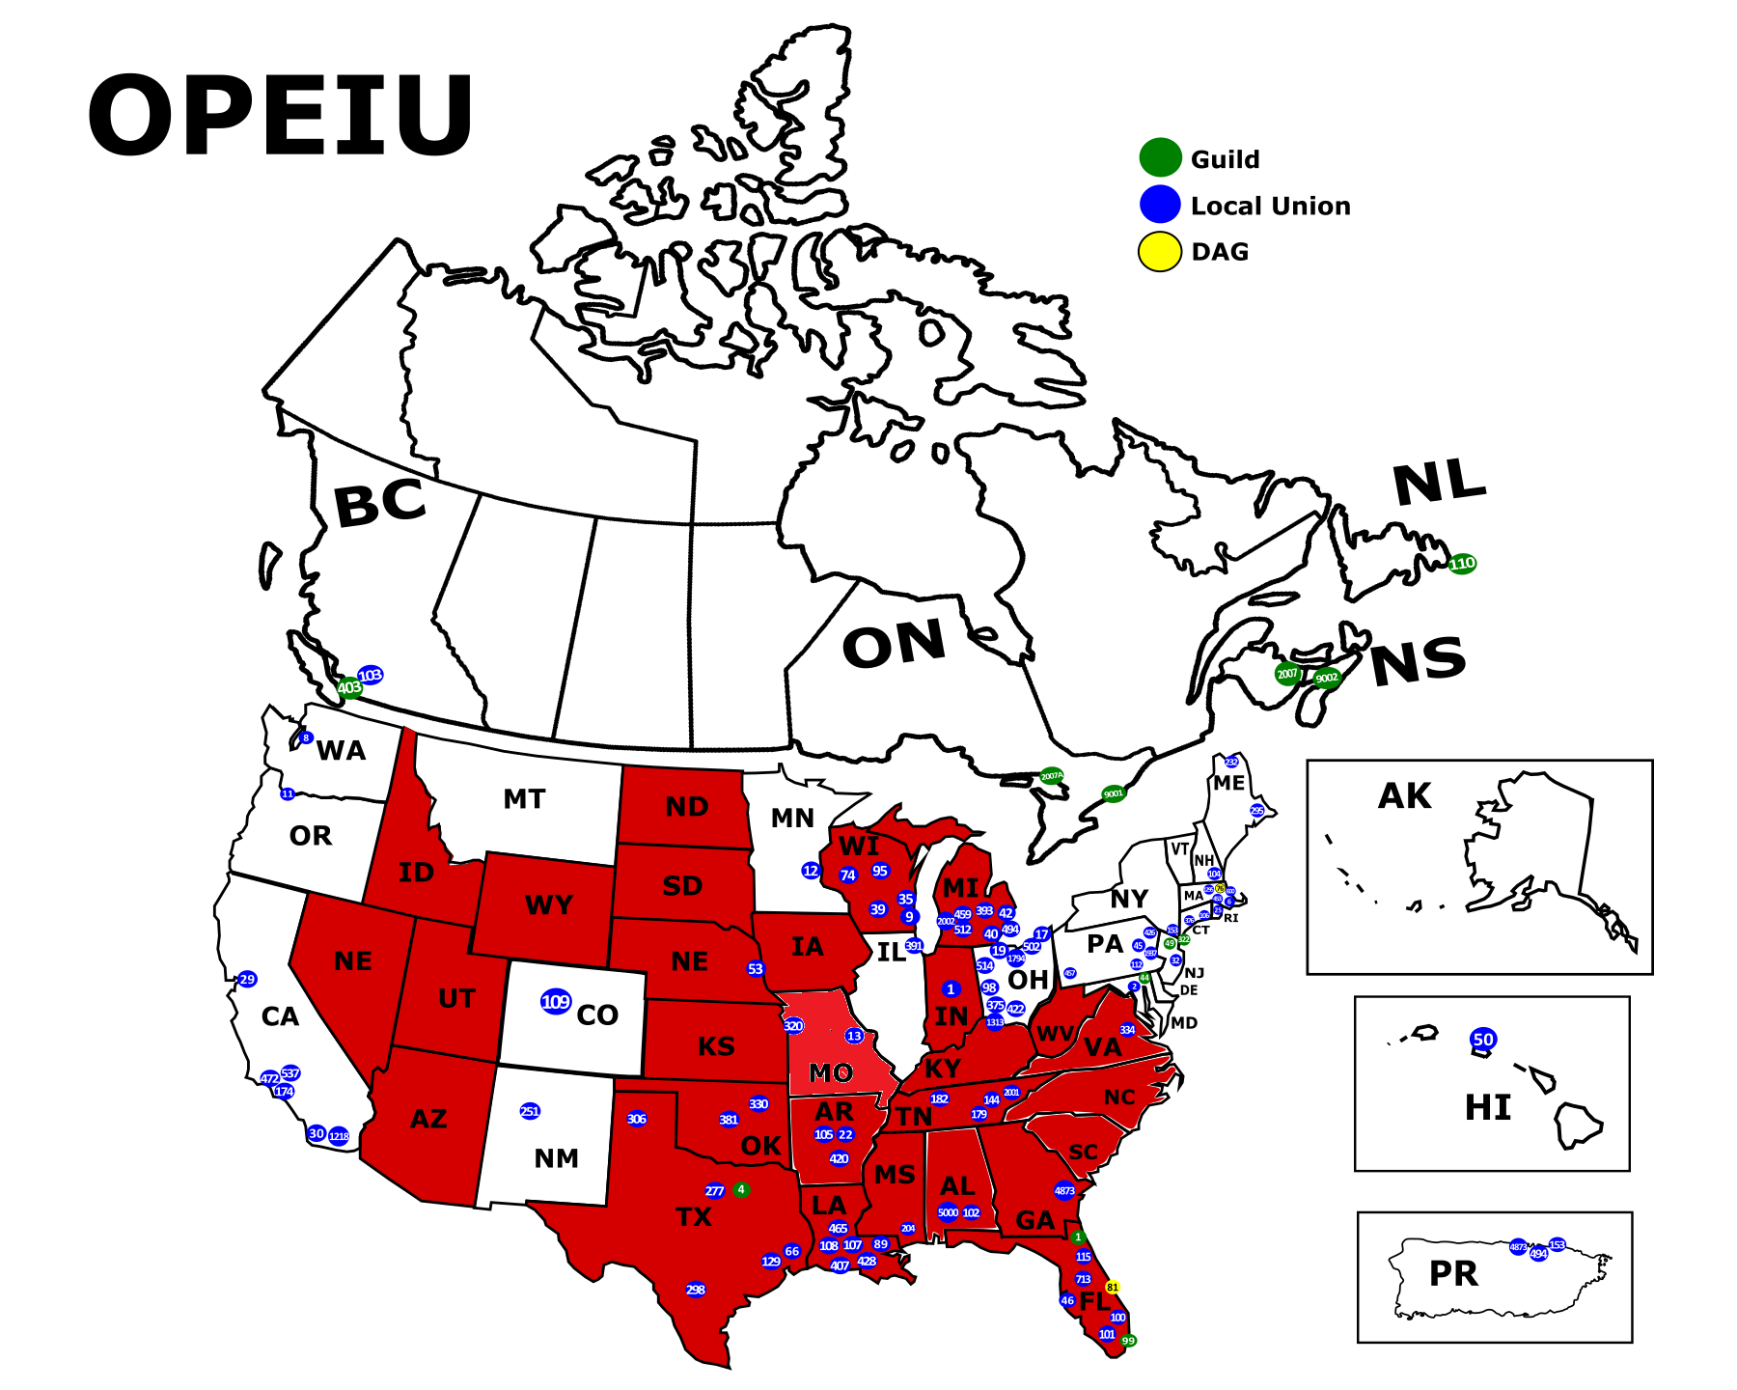
12,207 public employee members live in non-RTW states.
4,668 public employee members live in RTW states.

Slide 4
Where OPEIU Public Employees Work
City, County & State Government
Public District Hospitals
Public Housing Authorities
Public Transportation Authorities
Utilities
Other Public or Quasi-Public Entities

Slide 5
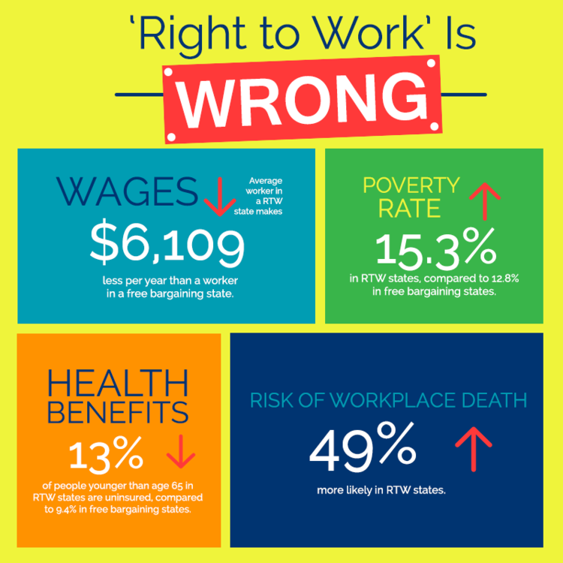
Deceptive Right-to-Work Laws Hurt Everyone
Go to www.aflcio.org to learn more about the impact of RTW laws on working people.

Slide 6
Current Environment
Jane Lauer Barker, Esq., Pitta LLP

Slide 7
Fair Share Fees (Public Sector)
The Supreme Court, in Abood v. Detroit Bd. of Ed. (1977), upheld fair share agreements in the public sector based upon desirability of labor peace and the problem of free riders.
This decision was challenged recently in Harris v. Quinn (2014). The Court, while casting serious doubt on the legitimacy of Abood, determined that it was not necessary at the time to overrule it. The Harris decision was 5-4.
Last term, the Court again faced the constitutionality of public sector agency fees in Friedrichs v. CTA (2016). The case was moved quickly to the Court. However, shortly before the decision was to be issued, Justice Scalia passed away leaving the Court with eight members. The Court split 4-4 and therefore affirmed the Ninth Circuit decision recognizing Abood as the law.

Slide 8
Fair Share Fees (Quasi-Public Groups)
In Harris v. Quinn (2014), the Court drew a distinction between the home care workers at issue and “full-fledged public employees.” There, the state declared that home care workers were considered public employees only for purposes of coverage under the state labor law. As a result, the Court found the Abood rationale for permitting fair share fees in the face of First Amendment challenge unpersuasive. Labor peace could not be ensured considering the union’s limited scope of representation. Without the protection of Abood, the Court held that fair share fees were impermissible under the First Amendment.

Slide 9
Fair Share Fees (Private Sector)
Two Railway Labor Act (“RLA”) cases established the principles for fair share in the private sector: Railway Employees' v. Hanson (1956) and Machinists v. Street (1961). These principles were later applied to actors under the NLRA in CWA v. Beck (1988).
In Harris v. Quinn (2014), the Court called Hanson’s First Amendment analysis “thin and . . . narrow” and found persuasive the dissent in Street, which argued that fair share is problematic. However, the Harris case did not overrule either.
In a recent case again challenging the constitutionality of the RLA’s fair share provision, Serna v. Transp. Workers Union of Am. (2016), the Fifth Circuit concluded that Hanson remains the current law of the land. Further, Serna held that an opt-out structure for agency fees was constitutional. The petition for cert was denied on January 9, 2017.

Slide 10
Fair Share Fees (Summary)
Fair share fees are currently permissible in both the public and private sector. However, the Supreme Court has created a distinction for non-full-fledged public employees. At the same time, in creating this distinction, the Court undermined many of the principles upon which Abood rests.

Slide 11
Exclusive Representative Status
In Minnesota State Board for Community Colleges v. Knight (1984), the Supreme Court held that exclusive representation by a democratically selected union does not, without more, violate the right of free association on the part of dissenting non-union members of the bargaining unit.
In D'Agostino v. Baker (2016), the First Circuit upheld the application of Knight to child care providers in a challenge to the constitutionality of a statutory scheme authorizing exclusive representation. The Supreme Court denied cert on June 13, 2016.

Slide 12
Challenges Ahead

Slide 13
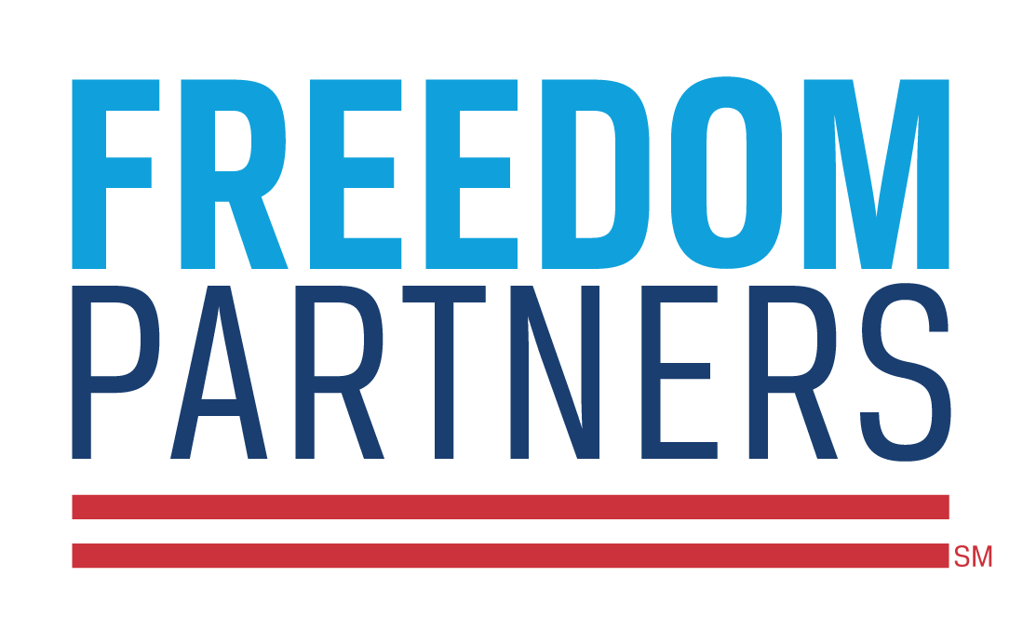




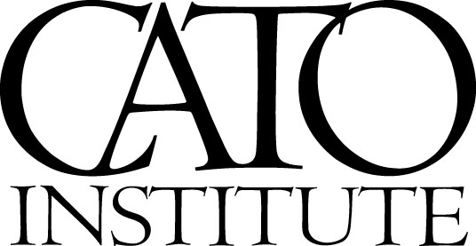
Opponents

Slide 14
Fair Share Fees (Public)
Janus v. AFSCME is likely to be the next case to reach the Supreme Court which will directly challenging fair share fees in the public sector. Its facts and issue are essentially the same as Friedrichs. It is scheduled to be argued before the 7th Circuit on March 1, 2017 and could theoretically be heard by the Supreme Court in the fall of 2017, with a decision coming by June of 2018.
Given that Justice Scalia was very unlikely to be the non-committal fifth vote in Harris necessary to overturn Abood, the split in Friedrichs suggests that the Justice unwilling to overturn Abood in Harris switched positions in Friedrichs. As a result, the appointment of another Justice willing to overrule Abood could spell the end of agency fees in the public sector.

Slide 15
Fair Share Fees (Quasi-public)
The Supreme Court may elect to hear a case concerning mandatory opt-out systems. The Washington state health care provider contract requires individuals to opt-out, otherwise pay dues by default. A Washington district court found the system constitutional. Hoffman v. Inslee (2016).
The Supreme Court could also elect reach the question of whether unions will be liable for dues collected from quasi-public employees pre-Harris. In both Hoffman and Jarvis v. Cuomo (2016), this issue was decided in favor of the unions. However, the Supreme Court just denied certiorari in the Jarvis case.

Slide 16
Fair Share Fees (Private)
Most concerning, a bill has been introduced in the U.S. House of Representatives by Reps. Steve King (R-Iowa) and Joe Wilson (R-SC), titled the “National Right-to-Work Act” (H.R. 785).This bill proposes to amend the NLRA and RLA to eliminate the ability to require any payment (i.e., agency fees) as a condition of employment. Thus, fair share in the private sector would be eliminated by virtue of the passage of this legislation.
Not altogether impossible for the Supreme Court to take up this issue at some point. Serna presented an opportunity under the RLA.

Slide 17
Exclusive Representational Status
Several cases are making their way up regarding the constitutionality of exclusive representation of non-full-fledged public employees. The plaintiffs argue that exclusive representation amounts to compelled association in violation of the First Amendment.
The furthest along was Jarvis v. Cuomo (2016), in which the Second Circuit held that exclusive representation status was constitutional even in a quasi-public setting based on Knight. However, as noted, the petition for cert. in Jarvis was just denied by the U.S. Supreme Court on February 27, 2017. There are similar cases pending in the Eighth and Seventh Circuits.
While the Supreme Court declined to hear this issue last term (D'Agostino), a shake-up of the Court may result in 4 Justices interested in hearing this matter in the near future.

Slide 18
Non-Member Rights
Non-member teachers in California are challenging union internal restrictions on their voting rights and employment-related benefits in Bain v. California Teachers Ass'n (2015). The district court found no state action as to warrant First Amendment application. This matter is on appeal to the Ninth Circuit.

Slide 19
United States Supreme Court
What to Expect and When

Slide 20
U.S. Supreme Court Procedures
Court hears cases from October to June or July
Case is added to calendar if four judges agree to accept the case
Steps:
  Writ of Certiorari filed by a party (telling court why it should hear the case) within 90 days of entry of judgment in lower court (extended if parties move for rehearing in lower court); opposition brief allowed within 30 days.
  If accepted by Court, then written briefs on the merits (45 days for petitioner; 35 days for respondent; 30 days for reply brief; amicus briefs may be filed as well; , oral arguments between October and April, Judge’s conference, opinion writing and announcement of decision.

Slide 21
Current Members
Name, Position | Birth Date | Party | Appointed By | Year Assumed Office
John Roberts, Chief | January 27, 1955 | Republican | George W. Bush | 2005
Anthony Kennedy, Associate | July 23, 1936 | Republican | Ronald Reagan | 1988
Clarence Thomas, Associate | June 23, 1948 | Republican | George H. W. Bush | 1991
Ruth Bader Ginsburg, Associate | March 15, 1933 | Democrat | Bill Clinton | 1993
Stephen Breyer, Associate | August 15, 1938 | Democrat | Bill Clinton | 1994
Samuel Alito, Associate | April 1, 1950 | Republican | George W. Bush | 2006
Sonia Sotomayor, Associate | June 25, 1954 | Independent | Barack Obama | 2009
Elena Kagan, Associate | April 28, 1960 | Democrat | Barack Obama | 2010

Slide 22
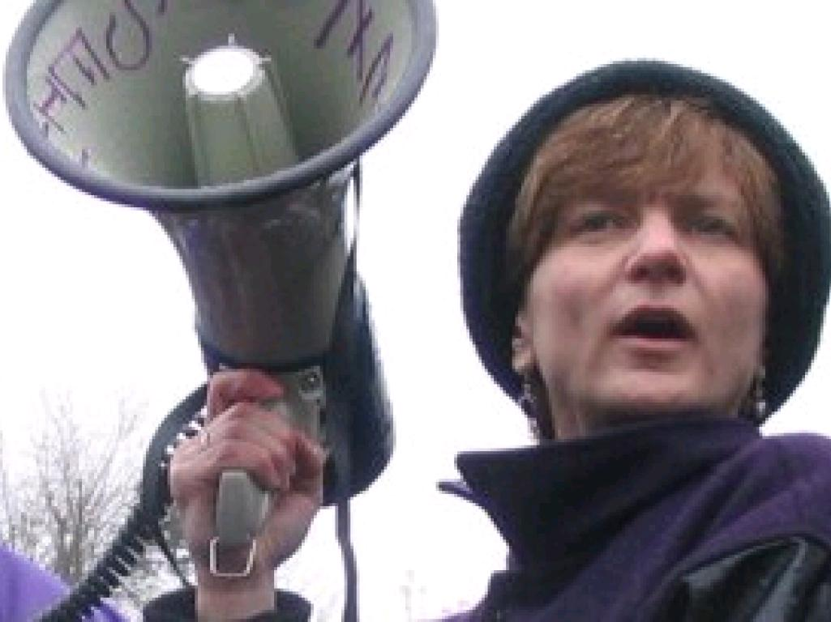
Kim Cook
Cornell Worker Institute
Past President, SEIU Local 925

Slide 23

We need a new path, a new playbook
“No matter how strong and effective we may have been in the past, we can’t continue on the same path. The rules are changing and we need a new playbook.”

Slide 24
Harris v Quinn
What we did and what we learned
Massive fair share membership sign up blitz
Didn’t talk to current members soon enough
Underestimated the anti-union forces
Sign up isn’t enough – member leadership development is key in long run

Slide 25
What to expect from the anti-union forces
  Mail to our members
  Email
  Ads
  Press
  Calls
  House-visit
  And more

Slide 28
Friedrich’s was happening and we did more
Member leadership – engaged at every level
Sign up campaign for fair share payers
Conversations and recommit of members
Improved communications and messaging
Administrative operations updated
Changed the role of staff – refocused
Strengthened community partnerships

Slide 29
Urgency!
Where to start now
1) Employee data
2) Member leadership development
3) Broad member engagement
4) New hire recruitment

Slide 30
Employee data
Audit membership lists and dues; identify fair share, potential member leaders
Contact information for all members
(email, phone, text, work address, social media, home address)
Map your membership
Update your data systems

Slide 31
Member leadership development
Members planning for this campaign and new reality – committee on the future
Member roles strengthened for organizing
Training, support and rewards
Staff focused on leader development
Use campaigns to increase member roles and engagement

Slide 32
Broad member outreach
Talk to every member and ask for recommit and new level of activity
Ask every fair share payer to join
Get your message right – about worker strength to win what members care about, not about the union losing dues – who is behind this

Slide 33
New hire recruitment
New employee orientation – get it, improve it
New hire sign up systems
Member leaders/stewards to do follow-up
Get new members involved early – social events, mentors, one on one lunches etc.

Slide 34
Other preparation
Contract language
Talk to your employers
Pursue new sign up methods like voice or electronic authorization
Prepare for possible loss of dues deduction
Deepen your labor and community partnerships
Pass state or local legislation to prepare for RTW
Budget planning for loss of dues
New systems of accountability
Change how we do our work for this new reality

Slide 35
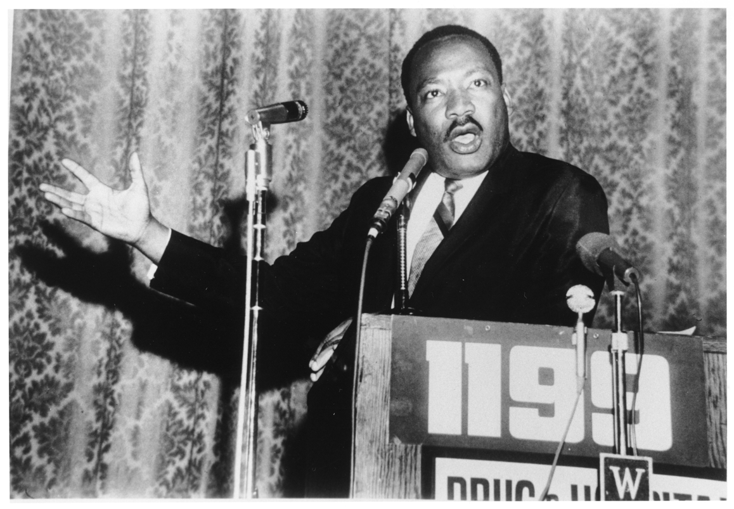
"In our glorious fight for civil rights, we must guard against being fooled by false slogans, such as 'right to work.'
It is a law to rob us of our civil rights and job rights. Its purpose is to destroy labor unions and the freedom of collective bargaining by which unions have improved wages and working conditions of everyone.”
–Dr. Martin Luther King Jr.

Slide 36
QUESTIONS?

Slide 37
Public Employee Sector
Two-Day Training
April 11-12, 2017
Hilton Chicago O’Hare Airport
Chicago, Illinois

